Slide 1
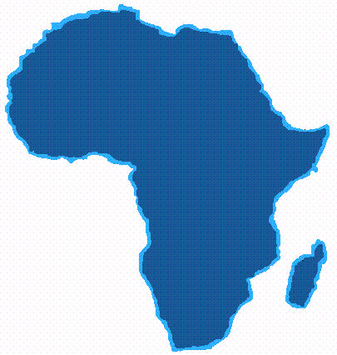
‘Blood’ Diamonds (1)
Mr X
Diamonds from W Africa
Purchase at market value
Transit country
Forward shipping
Europe-based dealer
Sale on at profit
Loans to syndicate
Purchase at market value
Transfer of profit to ‘parent company’
‘Loans’ repaid using criminal proceeds
Funds forwarded to terror group
Notes:
Use of ‘blood diamonds’ in relation to criminal funds – example
The example is based on a real case. ‘Blood diamonds’ were purchased at the local market value in Western Africa and shipped through another country, arriving eventually with a Europe-based diamond dealer, for sale on to other customers at a profit.
Amongst the various customers purchasing these diamonds were members of another diamond dealing family who were also involved in a number of criminal activities including illegal diamond trafficking. They raised loans which were used to purchase diamonds from the dealer. The terms of these loans were such that they were able to repay quickly, using criminal funds. In other words, the legitimate loan funds were exchanged for diamonds and then replaced with criminal funds. The diamonds could then be sold on legitimately at a profit.
Whilst using the sale of diamonds to help these criminals to launder their funds, the dealer was also using the profits from other sales to help fund terrorism. Profits from sales were transferred on to an intermediary entity, before being passed finally to Al Quaida and used to fund terrorism.

Slide 2
‘Blood’ Diamonds (2)
Key facts
Main source: diamond producing areas of Western Africa
Breakdown of central control: opportunities for criminal exploitation of production
Proceeds of diamond sales: used to fund armed conflict and terrorism
Links with terrorism: used by terrorist groups to finance terror activities
Money launderers’ perspective
High intrinsic value in compact form
Easy to hide, easy to transport across borders
High volume production and trading concentrated into relatively few locations
Notes:
Key facts
Diamond production across the world is concentrated into a relatively small number of countries, including several countries in Western Africa where war and conflict have led to the breakdown of formal and legitimate controls in the diamond-producing regions. In the absence of such controls the ‘warlords’ and criminal gangs have taken their opportunity to move in and exploit diamond production for their own ends.
Many of the proceeds of diamond sales from these regions are used by the warlords to fund arms purchases and further conflict. It is this association between bloodshed and diamond production in the region which has given rise to the term ‘blood diamonds’.
In recent years there have been increasing concerns that terror groups may also be using the market in ‘blood diamonds’ to fund their own activities.
Money launderers’ perspective
Diamonds and other precious gems have long been used by money launderers as a means to convert criminal cash into a high value, compact and easily tradable asset.
Their compactness and lack of weight and odour means that they can be easily concealed and are therefore easy to transport across borders.
Diamond production and diamond trading are both concentrated in a relatively small number of locations, and it is clearly in these locations or in transactions involving that particular vigilance for this money laundering typology is required.
As regards ‘blood diamonds’ the obvious high-risk jurisdictions are the diamond producing countries of Western Africa. High value, cross-border transactions involving these countries carry at least some risk of a link with the trade in ‘blood’ diamonds.

Slide 3
‘Blood’ Diamonds (3)
Possible ‘red flags’
Significant unexplained deposits from companies active in the diamond trade
Large scale cross-border funds transfers involving countries known to be a source of ‘blood diamonds’
Cross-border funds transfers involving nationals/residents of diamond producing areas of Western Africa
Unexplained large international funds transfers to known diamond traders, followed by immediate withdrawal in cash
Very ‘regular’ levels of funds and cash flow in diamond trading businesses (fluctuations would be more normal)
Any transaction with the diamond trade that cannot be explained by an individual’s or company’s known business
Notes:
Transactions that might give cause for concern and should certainly give rise to enhanced due diligence include the following:
Transactions that have originated in or passed through countries associated with the production of ‘blood’ diamonds
Any unusual transactions involving companies active in the diamond trade
Any cash transactions (deposits or withdrawals) that can be linked to the trade in diamonds
Any transaction that can be linked to the trade in diamonds and which does not fit with the known business of the individual or entity in question.
For more information, please see above.

